Slide 1
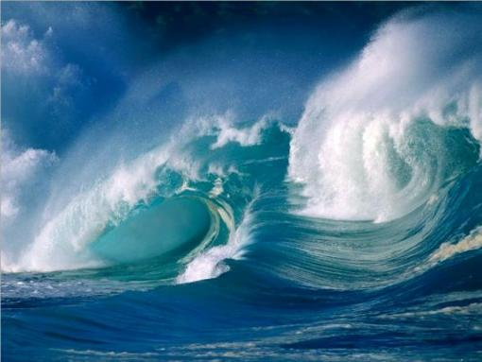
WAVES

Slide 2
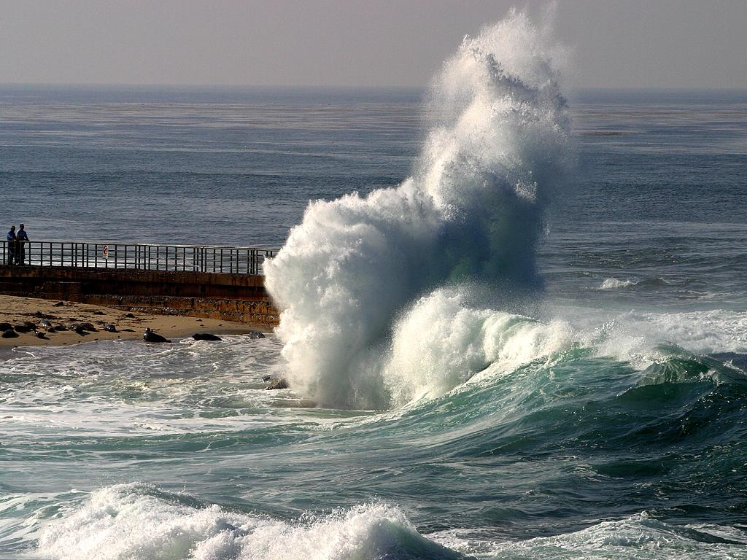
A wave is a disturbance that transfers energy through matter or space. Ex. Pebble or fish

Slide 3
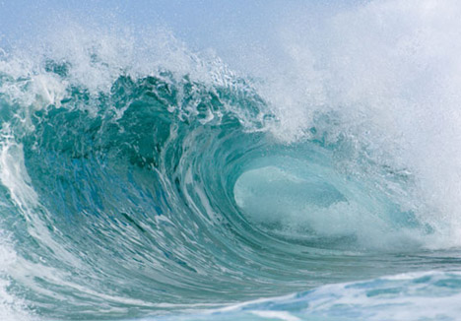
Many waves require a medium in order to transfer energy. A medium is a material that is distributed by a wave.

Slide 4
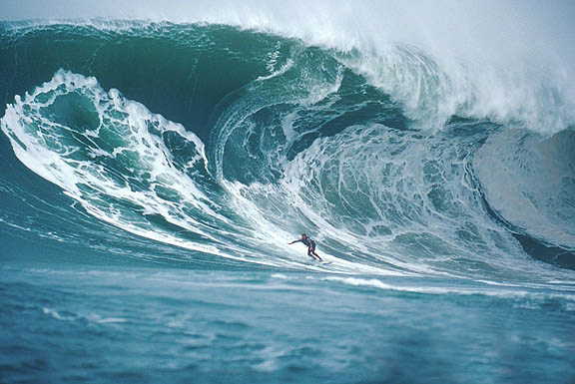
Sound waves require a medium, such as air, water, or a solid object, in order to reach your ears.

Slide 5
Waves move the particles from their original, or resting position. The particles move up and down or back and forth. After the wave passes, the particles return to their resting position.

Slide 6
Light waves and radio waves, do not require a medium. These waves belong to a group of waves called electromagnetic waves.

Slide 7
Electromagnetic waves can transfer energy through empty space. Ex. Light waves and radio waves

Slide 8
All waves have three characteristics in common: - amplitude -wavelength -frequency

Slide 9
Amplitude is the distance from the midpoint (resting position) of a wave to its top, or crest, or to its bottom, or trough. Ex. water wave with high amplitude is a tall wave A sound wave with high amplitude causes you to hear a loud sound

Slide 10
Wavelength is the distance from any point on a wave to the identical point on the next wave. Waves with short wavelengths transfer more energy than waves with long wavelengths.

Slide 11
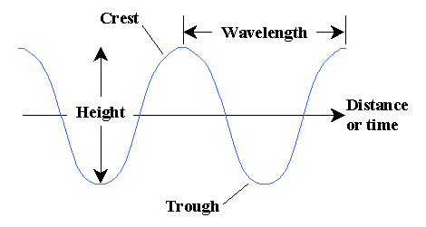

Slide 12
Frequency is the number of waves that pass a given point in one second. When frequency increases, wavelength decreases.

Slide 13
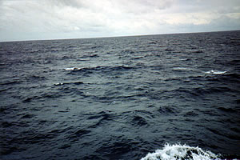
Waves are classified as either transverse or longitudinal. Transverse - particles of the medium vibrate perpendicular to the path of the wave. Longitudinal – particles of the medium vibrate parallel to the path of the wave.

Slide 14
A part of a longitudinal wave where the particles are pushed closer together is called a compression. A part where the particles spread out is called a rarefaction.

Slide 15
